Slide 1
DATA SCIENCE
Industrial Copper Modelling Application
GOWRI SANKER L

Slide 2
Objective
The copper industry deals with less complex data related to sales and pricing.
A machine learning regression model can address these issues by utilizing advanced techniques such as data normalization, feature scaling, and outlier detection, and leveraging algorithms that are robust to skewed and noisy data.
Another area where the copper industry faces challenges is in capturing the leads. A lead classification model is a system for evaluating and classifying leads based on how likely they are to become a customer .

Slide 3
Steps followed
Objective(Creating the streamlit)
Data collection
Data accuracy
Checking the Data
Data pre-processing
Exploratory Data Analysis (EDA)
Encoding

Slide 4
Contd……..
Machine Learning
Training model
Selection of algorithm
Data prediction
Data accuracy level

Slide 5
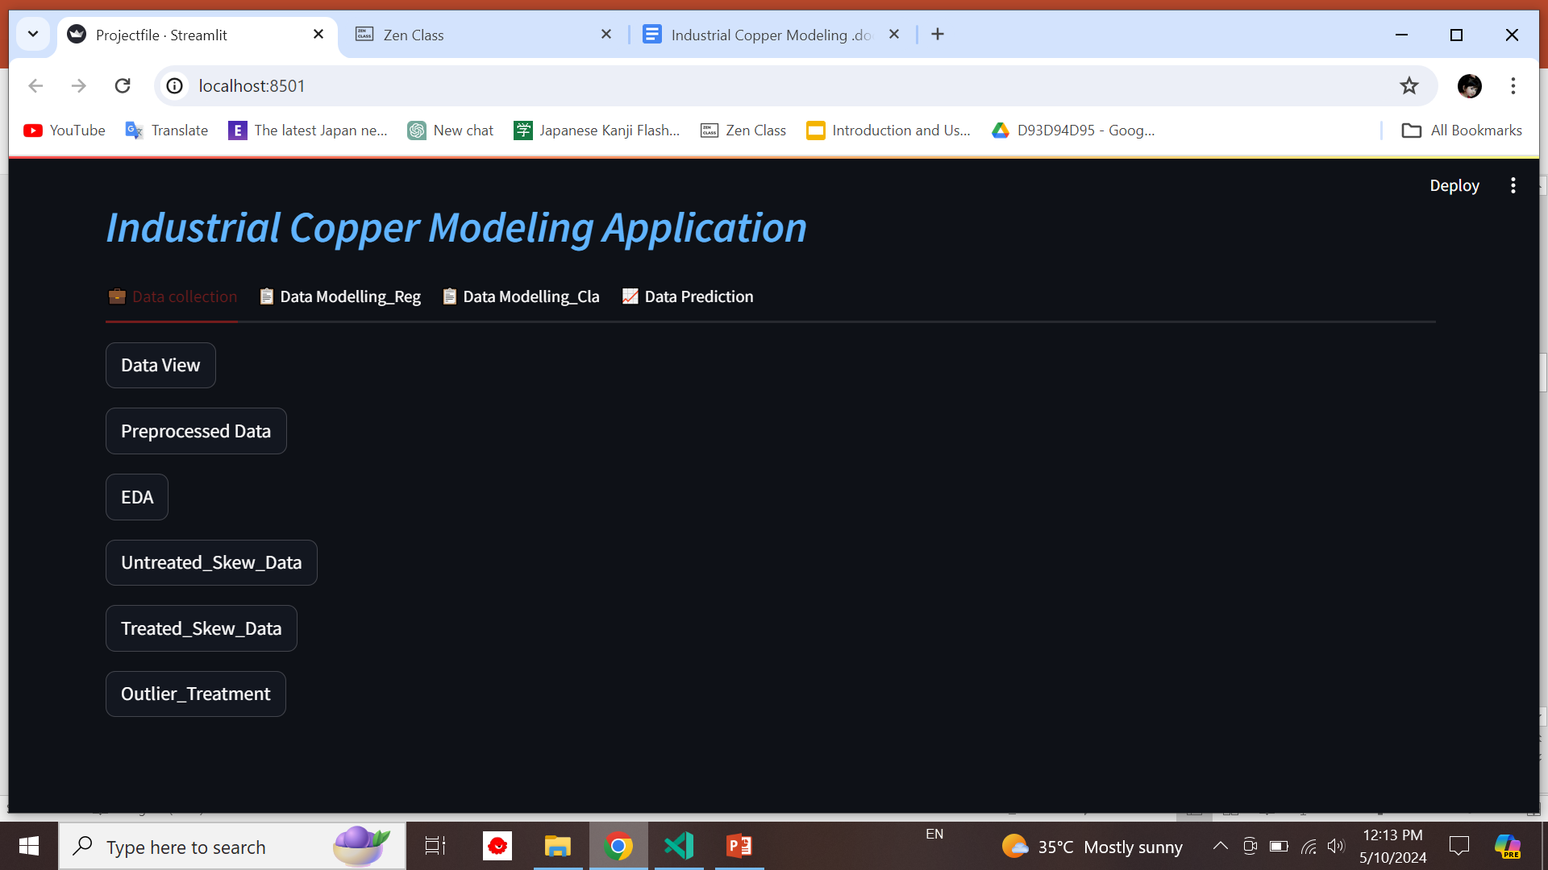

Slide 6
Objective
Problem Definition
Domain Knowledge
Data Relevance
Data Quality
Data Accessibility
Ethical Considerations
Data Collection Plan
Data Governance

Slide 7
Data collection
Web Scraping
APIs (Application Programming Interfaces)
Sensor Data
Surveys and Questionnaires
Publicly Available Datasets
Transactional Data
Internal Data Sources

Slide 8
Checking the Data
Data type
Data Mismatch
Data harmonization

Slide 9
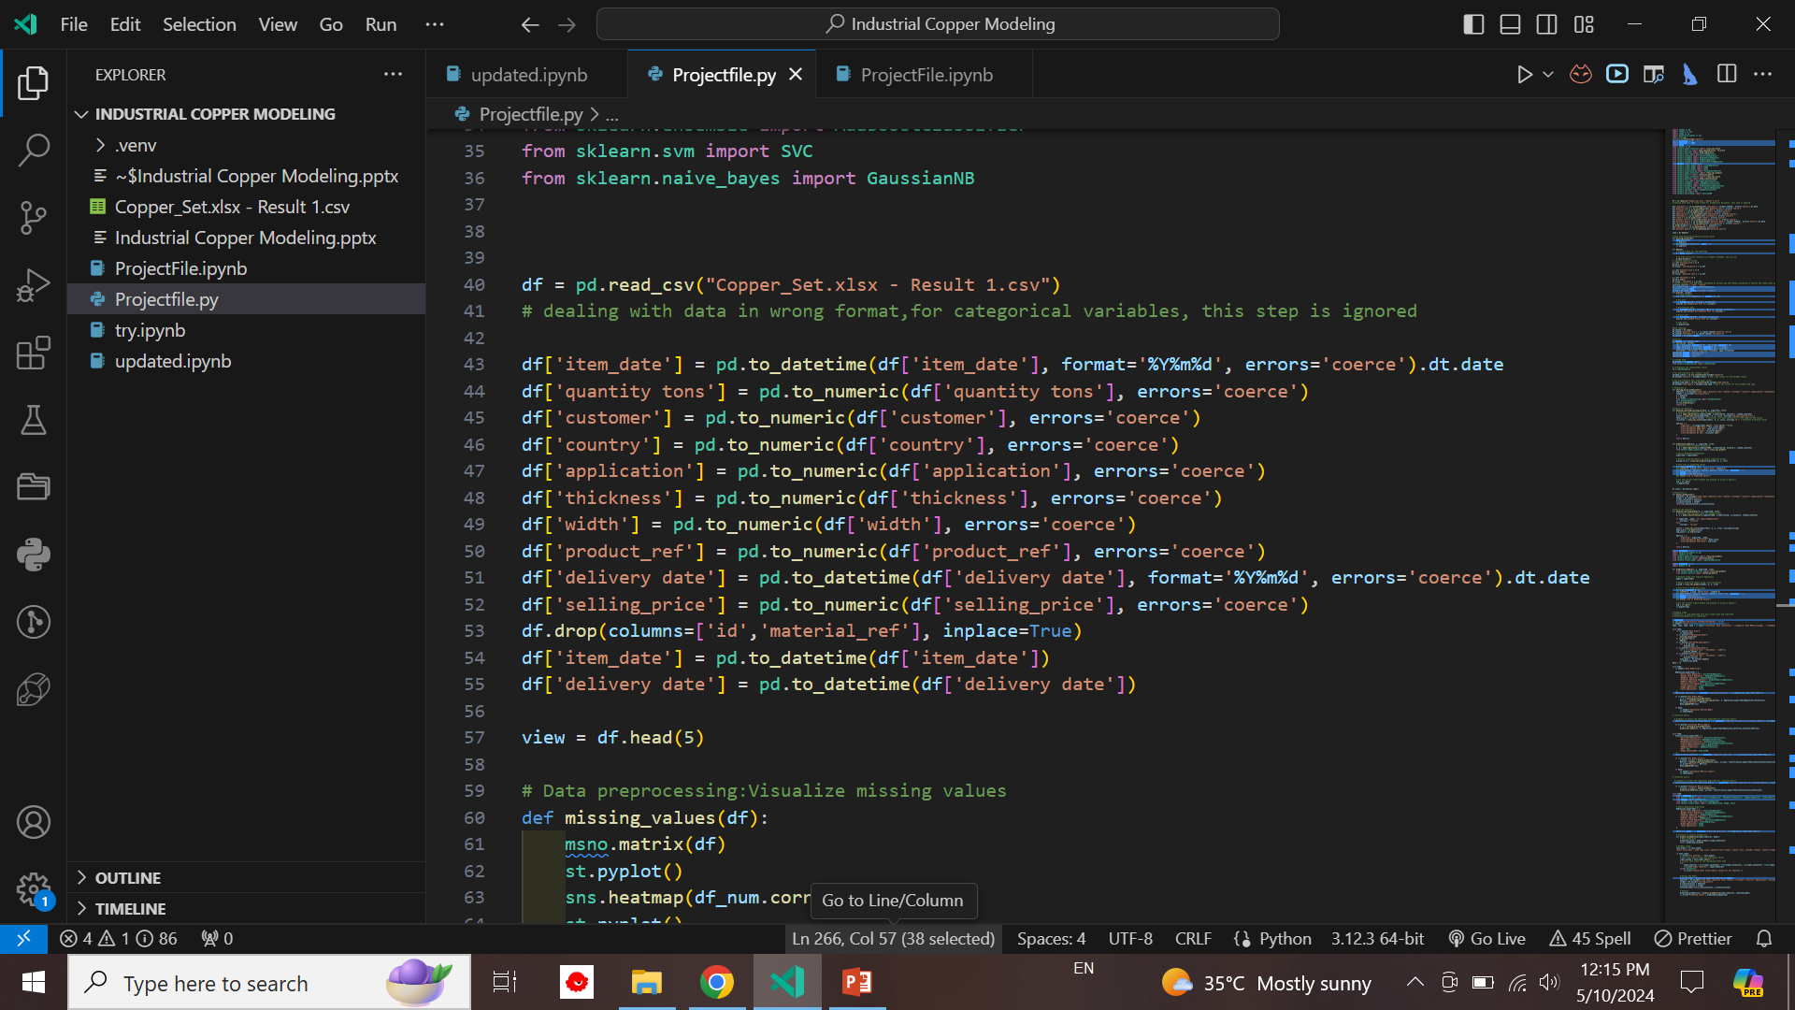

Slide 10
Data pre-processing
Handling missing values
Mean
Median
Mode
Removing duplicate records
Correcting formatting issues

Slide 11
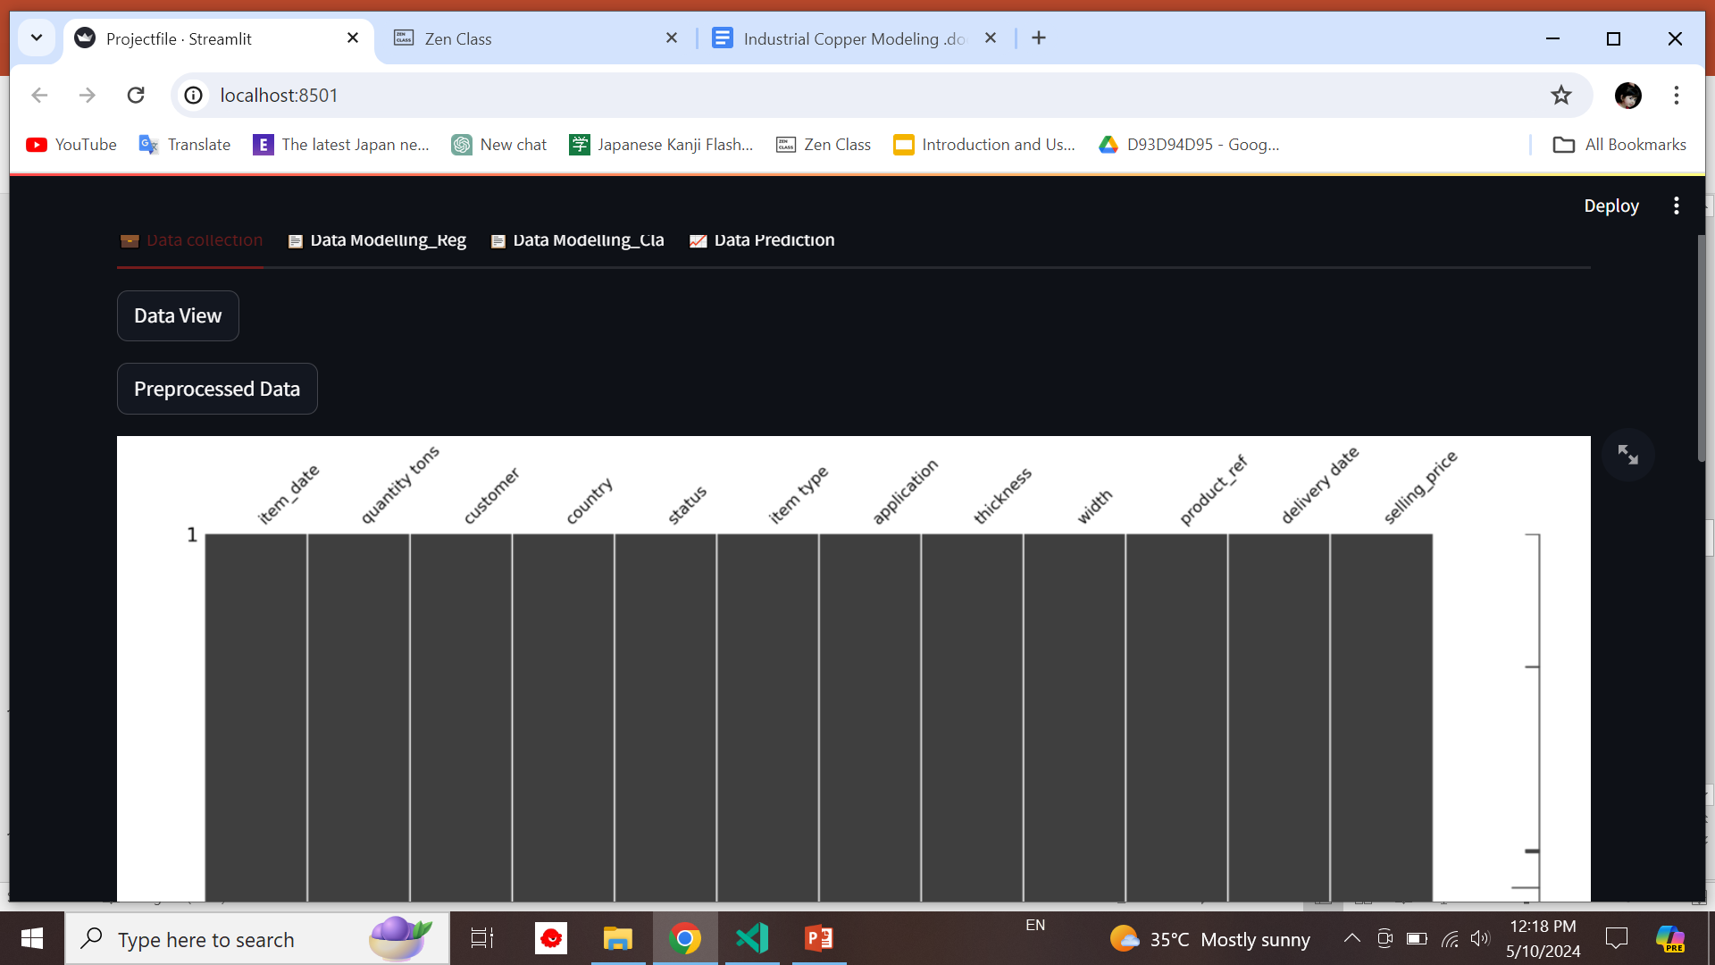

Slide 12
Exploratory Data Analysis (EDA)
Data Visualization
Missing Values
Outlier Detection
Skewness
Correlation Analysis

Slide 13
Encoding
Process of converting categorical variables into numerical representations that can be used for analysis or modeling.
Categorical variables represent qualitative data with a limited number of distinct categories or levels.
Encoding is necessary because many machine learning algorithms require numerical input data.

Slide 14
Machine Learning
Finding the Data type
Supervised Learning
Unsupervised Learning
Clustering
Selection of Feature and Target
Algorithm selection
Train the model
Finding the best the model
Confusion matrix

Slide 15
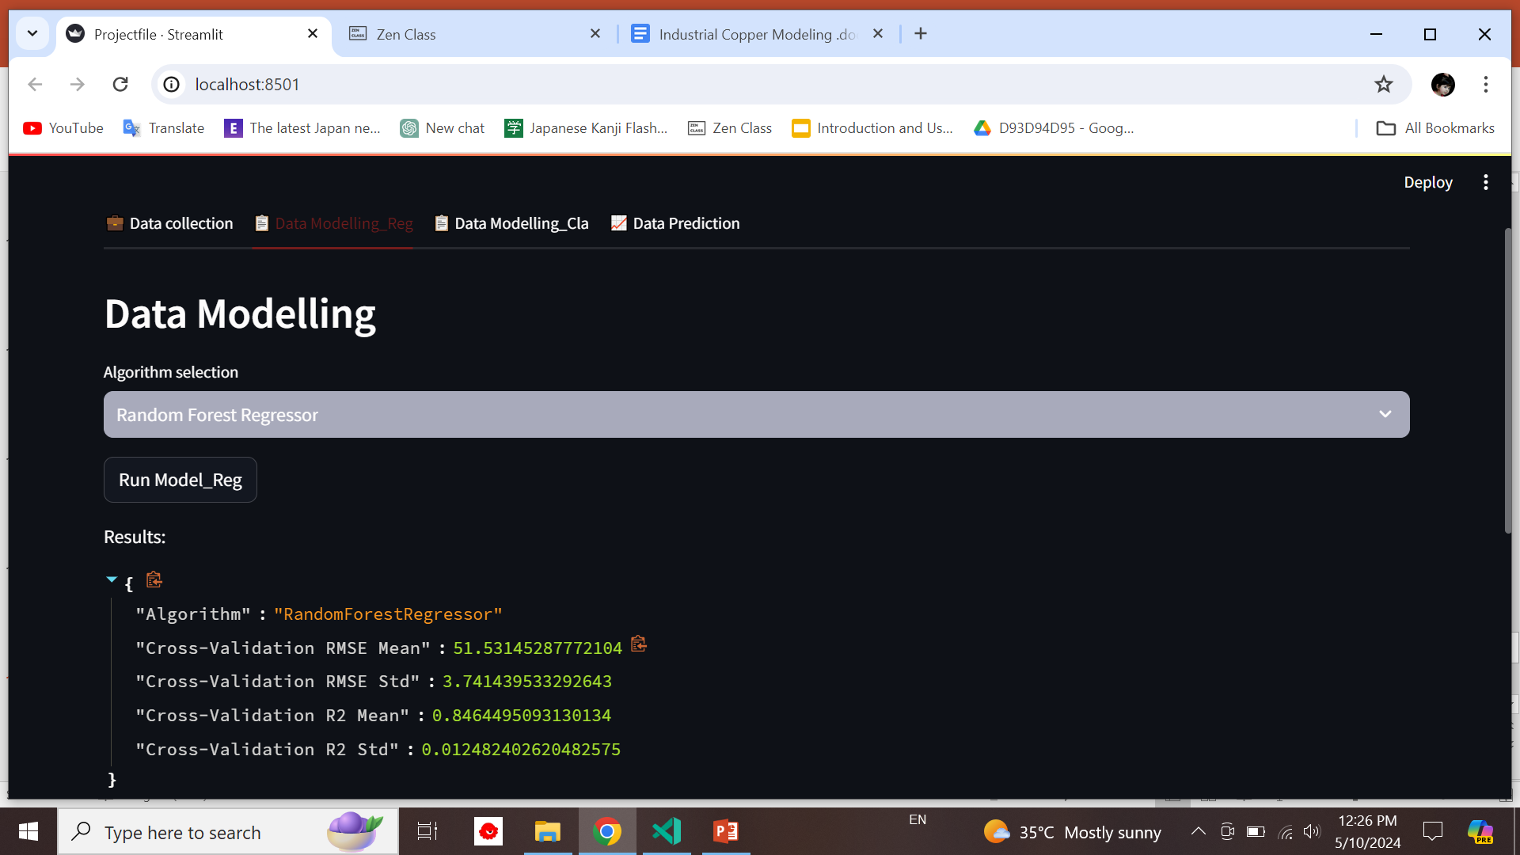

Slide 16
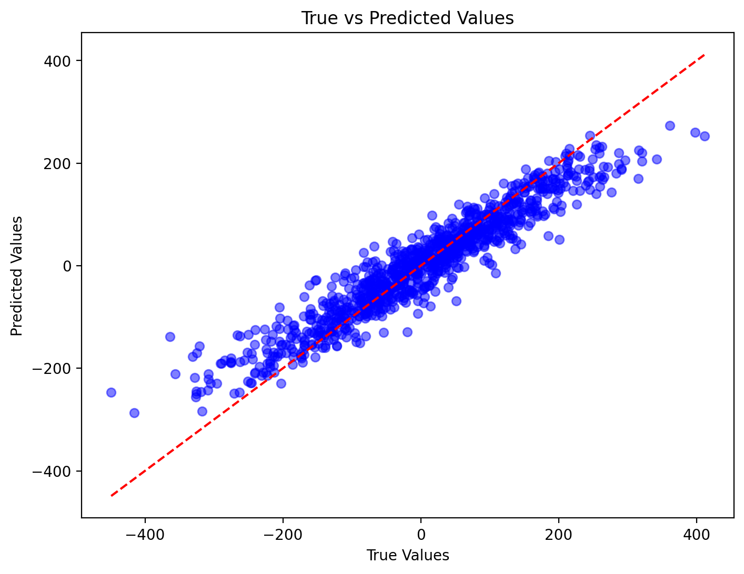

Slide 17
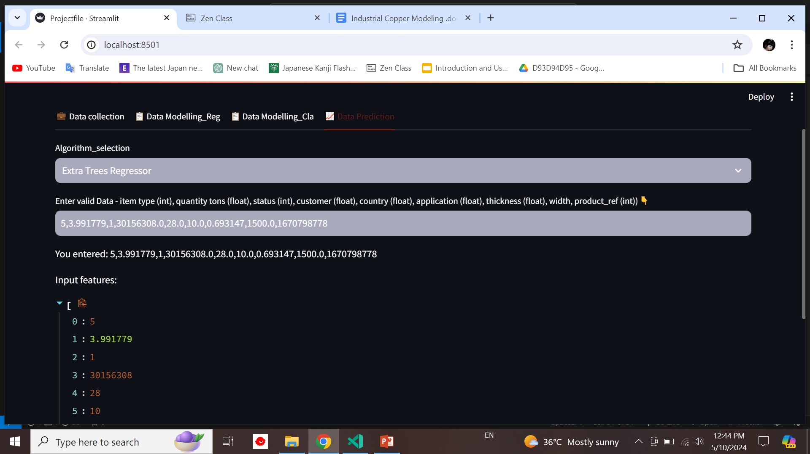
Data prediction

Slide 18
Prescriptive Analysis
Prescriptive analysis is a branch of data analytics that focuses on providing recommendations or prescriptions for actions to optimize outcomes.

Slide 19
Thank you!

